Slide 1






Competitive Integrated Employment and Customized Employment

Slide 2
Competitive Integrated Employment
Competitive: At or above minimum wage, comparable to others doing the same jobs, with the same benefits and opportunities as others doing the same job.
Integrated: In the community with people with and without disabilities
Notes:
Danielle

Slide 3
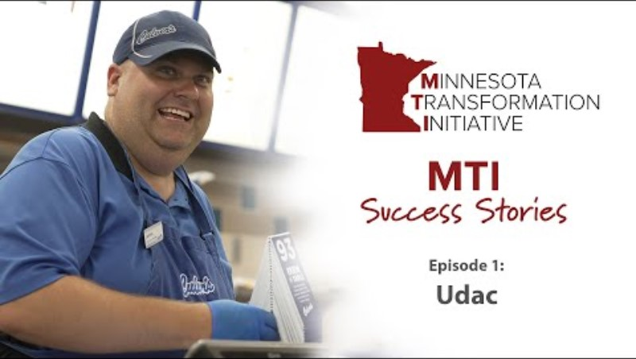
Success Stories: Episode1 - UDAC
Notes:
Danielle

Slide 4
Customized Employment
Focus on learning as much about the person through “Discovery.”
Discovery is evidence-based and leads to better outcomes
“CE utilizes an individualized approach to employment planning and job development — one person at a time and one employer at a time. Because CE jobs are a good fit for the person and the employer, there is greater employee satisfaction and productivity, resulting in enhanced retention and profitability for employers.” National Disability Institute
Discovery & Customized Employment - National Disability Institute
Notes:
Amy

Slide 5
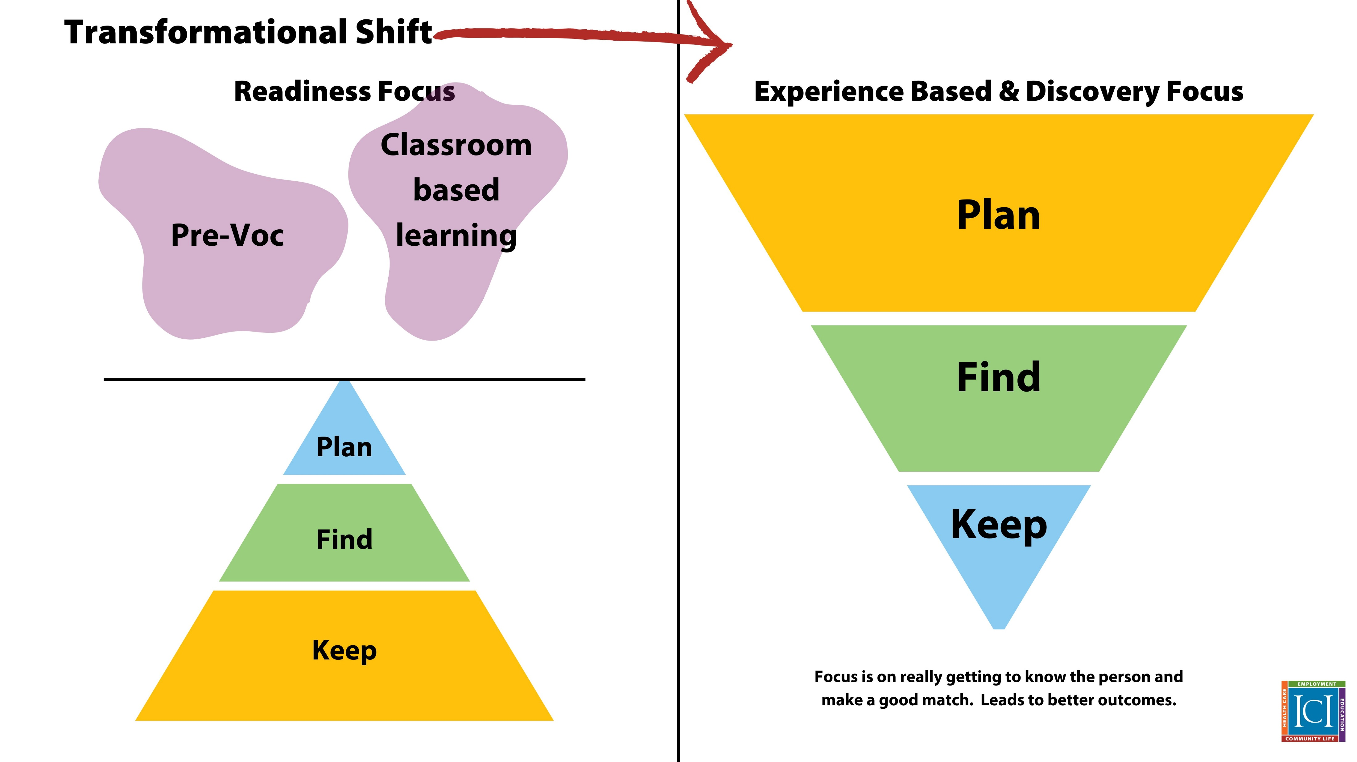
Customized Employment
Notes:
Amy

Slide 6
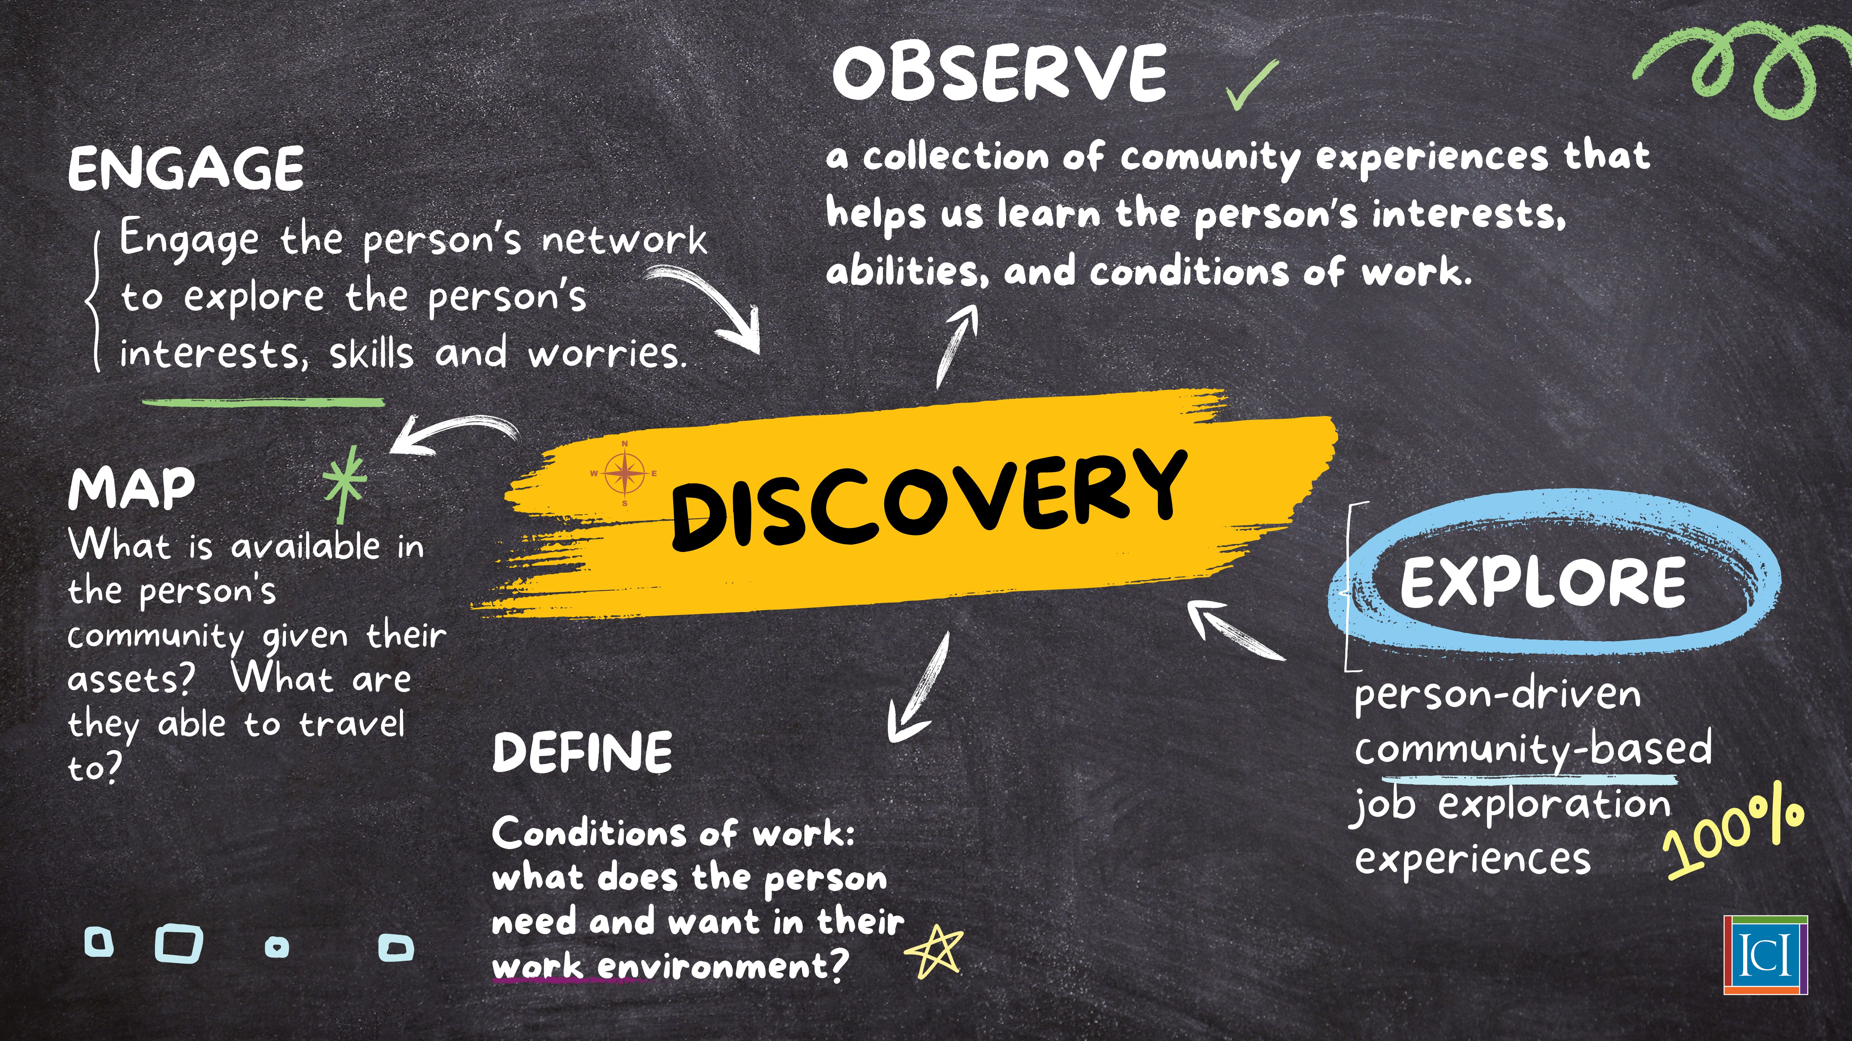
Notes:
Amy

Slide 7

Success Stories: Episode 3-Customized Employment in Action
Notes:
Danielle

Slide 8
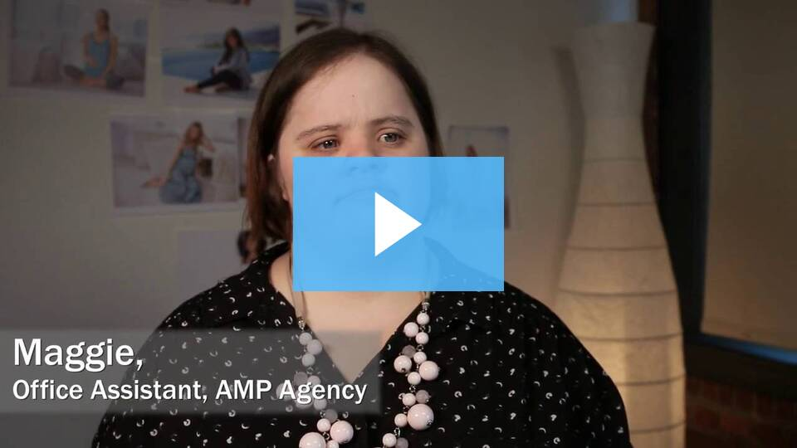
Job Carve Outs: Maggie's Story
Maggie full version
www.thinkwork.org/maggie-carving-out-job-increase-business-efficiency
Notes:
Amy
Maggie already worked at a grocery store, but wanted to work in an office too.
What happened:
Maggie is a fast learner who enjoys working in the creative environment at AMP. She has worked at AMP for two years, in addition to her part-time job at the grocery store. She works at AMP four hours a day, three days a week, and earns ten dollars per hour, and works four hours a day for two days a week at the grocery store.
Lessons Learned
The job developers' effort to get to know the staff at AMP and their needs gave them the credibility to make valuable suggestions to the CEO and Serena as they created Maggie's job.
Carving out a new position from Serena's extra tasks created a perfect position for Maggie, while allowing Serena to focus on new responsibilities.
Creating this new job not only benefited a new employee, but also improved the running of the business.
The job coach was important to Maggie's smooth transition into the company. By taking time at the beginning to learn tasks and communicate expectations, Maggie, her job coach, and the office manager set the stage for Maggie to succeed.

